Slide 1
Chapter 3
Floating point: Single and Double precision representations
Representing positive and negative floating-point numbers
Floating point Addition (and subtraction)
Floating point Multiplication and Division

Slide 2
Multiplication
First things first
If we multiply two 4 bit numbers, the result could be 8 bits long
For example 1111 * 1111 = 1110 0001 15 * 15 = 225
Likewise, if we multiply two 64 bit numbers, we may have 128 bit result
ARMv8 includes 3 MUL instructions.
MUL X_{i}, X_{j}, X_{k} : X_{i} contains the lower 64 bits of X_{j} *X_{k}
SMULH X_{i}, X_{j}, X_{k} : X_{i} contains upper 64 bits of signed X_{j} *X_{k}
UMULH X_{i}, X_{j}, X_{k} : X_{i} contains upper 64 bits of unsigned X_{j} *X_{k}
How do we perform long hand multiplication? Consider 15*34
15* 4 60
15 * 3 x 45 → we add this one position to the left (shift left!)
--------------
510
Let us try this with binary numbers say 15 * 3 or 1111 * 0011 (unsigned number for now)

Slide 3
 |  |  | 1 | 1 | 1 | 1
 |  | X | 0 | 0 | 1 | 1
 |  |  | 1 | 1 | 1 | 1
 |  | 1 | 1 | 1 | 1
 | 0 | 0 | 0 | 0
0 | 0 | 0 | 0
0 | 1 | 0 | 1 | 1 | 0 | 1
Some definitions: first operand (1111) is called multiplicand
Second operand (0011) is called multiplier
Result is called product
Unlike decimal we only need 1* multiplicand or zero for adding
Shift Multiplicand to left Shift multiplier to the right (“shift and add”)
Shifted left
Multiplicand |  |  |  |  |  |  |  |  |  |  |  |  |  | 1 | 1 | 1 | 1
Multiplier |  |  |  |  |  |  |  |  |  |  |  |  |  | 0 | 0 | 1 | 1
Product |  | 0 | 0 | 0 | 0 | 0 | 0 | 0 | 0
SHR multiplier |  |  |  |  |  |  |  |  |  |  |  |  |  |  | 0 | 0 | 1 | 1
Add Multiplicand |  |  |  |  | 1 | 1 | 1 | 1
= | 0 | 0 | 0 | 0 | 1 | 1 | 1 | 1
SHL multiplicand |  |  |  |  |  |  |  |  |  |  |  |  | 1 | 1 | 1 | 1 | 0
SHR multiplier |  |  |  |  |  |  |  |  |  |  |  |  |  |  |  | 0 | 0 | 1
add Multiplicand |  |  |  | 1 | 1 | 1 | 1 | 0
= |  |  | 1 | 0 | 1 | 1 | 0 | 1
SHL multiplicand |  |  |  |  |  |  |  |  |  |  |  | 1 | 1 | 1 | 1 | 0 | 0
SHR multiplier |  |  |  |  |  |  |  |  |  |  |  |  |  |  |  |  | 0 | 0
Add Zero |  | 0 | 0 | 0 | 0 | 0 | 0 | 0
= |  | 0 | 1 | 0 | 1 | 1 | 0 | 1
SHL multiplicand |  |  |  |  |  |  |  |  |  |  | 1 | 1 | 1 | 1 | 0 | 0 | 0
SHR multiplier |  |  |  |  |  |  |  |  |  |  |  |  |  |  |  |  |  | 0
Add Zero | 0 | 0 | 0 | 0 | 0 | 0 | 0 | 0
= | 0 | 0 | 1 | 0 | 1 | 1 | 0 | 1
DONE

Slide 4
 |  |  |  | 1 | 1 | 1 | 1
 |  |  | X | 1 | 0 | 1 | 1
 |  |  |  | 1 | 1 | 1 | 1
 |  |  | 1 | 1 | 1 | 1
 |  | 0 | 0 | 0 | 0
 | 1 | 1 | 1 | 1
1 | 0 | 1 | 0 | 0 | 1 | 0 | 1
11 * 15
Some definitions: first operand (1111) is called multiplicand
Second operand (1011) is called multiplier
Result is called product
Unlike decimal we only need 1* multiplicand or zero for adding
Shift Multiplicand to left Shift multiplier to the right (“shift and add”)
Shifted left
Multiplicand |  |  |  |  |  |  |  |  |  |  |  |  |  | 1 | 1 | 1 | 1
Multiplier |  |  |  |  |  |  |  |  |  |  |  |  |  | 1 | 0 | 1 | 1
Product |  | 0 | 0 | 0 | 0 | 0 | 0 | 0 | 0
SHR multiplier |  |  |  |  |  |  |  |  |  |  |  |  |  |  | 1 | 0 | 1 | 1
Add Multiplicand |  |  |  |  | 1 | 1 | 1 | 1
= | 0 | 0 | 0 | 0 | 1 | 1 | 1 | 1
SHL multiplicand |  |  |  |  |  |  |  |  |  |  |  |  | 1 | 1 | 1 | 1 | 0
SHR multiplier |  |  |  |  |  |  |  |  |  |  |  |  |  |  |  | 1 | 0 | 1
add Multiplicand |  |  |  | 1 | 1 | 1 | 1 | 0
= |  |  | 1 | 0 | 1 | 1 | 0 | 1
SHL multiplicand |  |  |  |  |  |  |  |  |  |  |  | 1 | 1 | 1 | 1 | 0 | 0
SHR multiplier |  |  |  |  |  |  |  |  |  |  |  |  |  |  |  |  | 1 | 0
Add Zero |  | 0 | 0 | 0 | 0 | 0 | 0 | 0
= |  | 0 | 1 | 0 | 1 | 1 | 0 | 1
SHL multiplicand |  |  |  |  |  |  |  |  |  |  | 1 | 1 | 1 | 1 | 0 | 0 | 0
SHR multiplier |  |  |  |  |  |  |  |  |  |  |  |  |  |  |  |  |  | 1
add Multiplicand | 0 | 1 | 1 | 1 | 1 | 0 | 0 | 0
= | 1 | 0 | 1 | 0 | 0 | 1 | 0 | 1
DONE
The multiplier is now shifted down to Zero
Note that the multiplier shrank at the same speed that the product grew

Slide 5
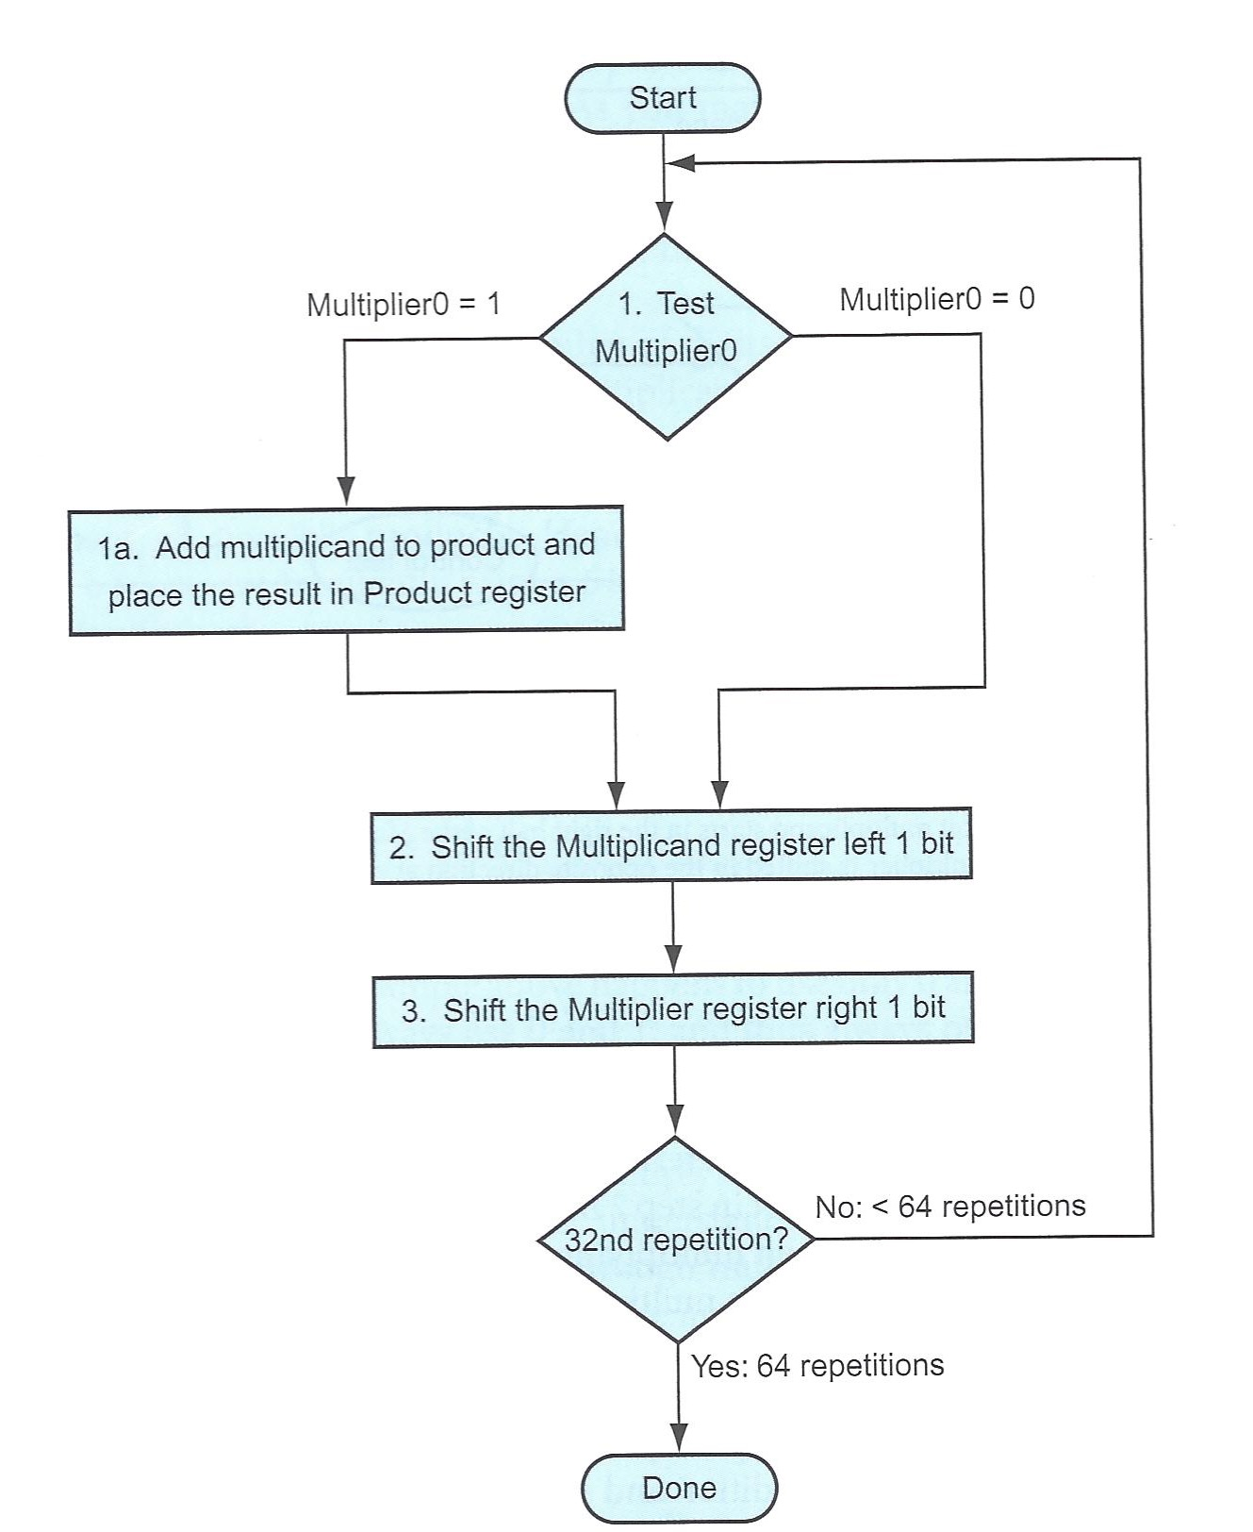
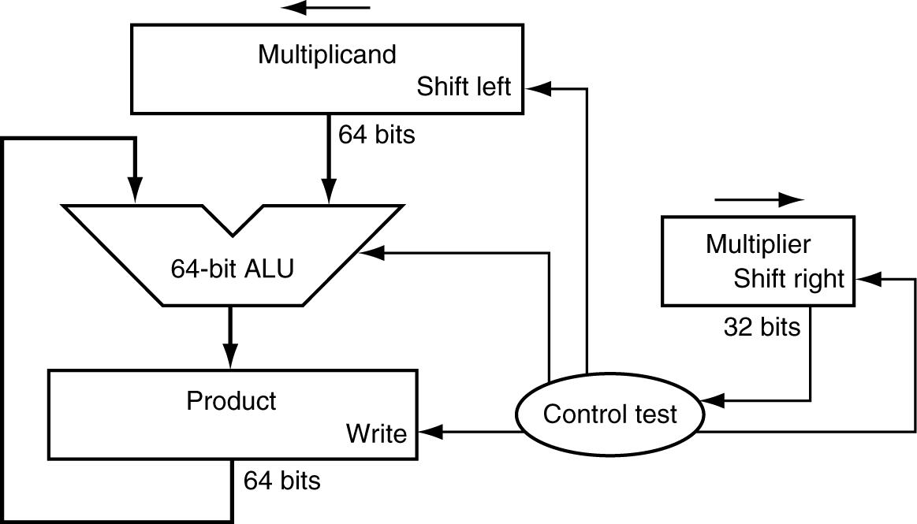
Multiplication
Registers needed
64 bit multiplicand; 64 bit multiplier 128 bit product
Multiplier register will be zero at the end
Image from book is wrong there are 64 reps

Slide 6
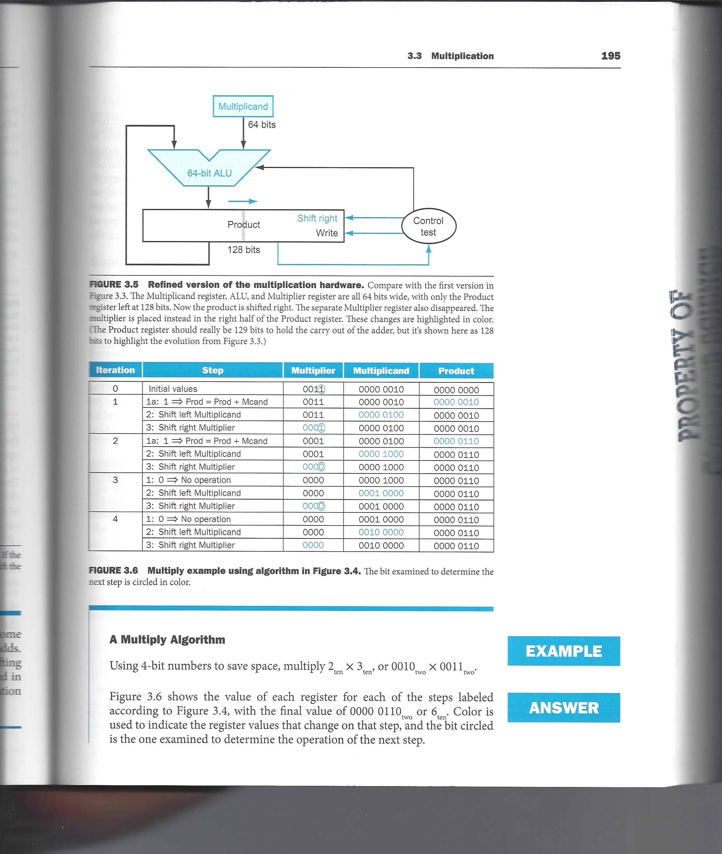
Multiplication
Note the multiplier register becomes zero in the end.
Instead let us do the following
64 bit multiplicand register and 128 bit product
initially store multiplier in the right 64 bits of the product (or result) register
Instead of shifting multiplicand left, shift product right (multiplier bits are shifted out)
And we will add (un-shifted) multiplicand to the LEFT HALF of the product
Add to the left half

Slide 7
Multiplication
 |  | 1 | 1 | 1 | 1
 | * | 1 | 0 | 1 | 1
Multiplier in RIGHT HALF of
Product register
left half of result is zero
We shift result register right on every cycle
Example: 15*11 =165
1111 * 0011
Initial result register = 0000 1011
We are dealing with unsigned numbers
So, the most significant bit does not indicate if the number is negative or positive
 | Product register |  |  | 0 | 0 | 0 | 0 | 1 | 0 | 1 | 1
 |  | SR |  | 0 | 0 | 0 | 0 | 0 | 1 | 0 | 1 | 1
 |  | + |  | 1 | 1 | 1 | 1
 |  |  |  | 1 | 1 | 1 | 1 | 0 | 1 | 0 | 1
 |  | SR |  | 0 | 1 | 1 | 1 | 1 | 0 | 1 | 0 | 1
 |  | + |  | 1 | 1 | 1 | 1
 |  |  | 1 | 0 | 1 | 1 | 0 | 1 | 0 | 1 | 0
 |  | SR |  | 1 | 0 | 1 | 1 | 0 | 1 | 0 | 1 | 0
 |  | + |  | 0 | 0 | 0 | 0
 |  |  |  | 1 | 0 | 1 | 1 | 0 | 1 | 0 | 1
 |  | SR |  | 0 | 1 | 0 | 1 | 1 | 0 | 1 | 0 | 1
 |  | + |  | 1 | 1 | 1 | 1
 |  |  | 1 | 0 | 1 | 0 | 0 | 1 | 0 | 1 | 0
 |  | SR |  | 1 | 0 | 1 | 0 | 0 | 1 | 0 | 1

Slide 8
Multiplication
An Example: 54*11 or 0011 0110 * 0000 1011. First normal multiplication
Multiplicand (54) | 0 | 0 | 1 | 1 | 0 | 1 | 1 | 0
Multiplier (11) | 0 | 0 | 0 | 0 | 1 | 0 | 1 | 1
Initialize Result Reg w/ multiplier | 0 | 0 | 0 | 0 | 0 | 0 | 0 | 0 | 0 | 0 | 0 | 0 | 1 | 0 | 1 | 1
LSB =1, ADD multiplicand | 0 | 0 | 1 | 1 | 0 | 1 | 1 | 0
= | 0 | 0 | 1 | 1 | 0 | 1 | 1 | 0 | 0 | 0 | 0 | 0 | 1 | 0 | 1 | 1
Shift right | 0 | 0 | 0 | 1 | 1 | 0 | 1 | 1 | 0 | 0 | 0 | 0 | 0 | 1 | 0 | 1
LSB =1, ADD multiplicand | 0 | 0 | 1 | 1 | 0 | 1 | 1 | 0
= | 0 | 1 | 0 | 1 | 0 | 0 | 0 | 1 | 0 | 0 | 0 | 0 | 0 | 1 | 0 | 1
shift right | 0 | 0 | 1 | 0 | 1 | 0 | 0 | 0 | 1 | 0 | 0 | 0 | 0 | 0 | 1 | 0
LSB =0, Add zero*multiplicand
NO add, just shift right | 0 | 0 | 0 | 1 | 0 | 1 | 0 | 0 | 0 | 1 | 0 | 0 | 0 | 0 | 0 | 1
LSB =1, ADD multiplicand | 0 | 0 | 1 | 1 | 0 | 1 | 1 | 0
= | 0 | 1 | 0 | 0 | 1 | 0 | 1 | 0 | 0 | 1 | 0 | 0 | 0 | 0 | 0 | 1
Shift right | 0 | 0 | 1 | 0 | 0 | 1 | 0 | 1 | 0 | 0 | 1 | 0 | 0 | 0 | 0 | 0
LSB=0, no add, Shift right | 0 | 0 | 0 | 1 | 0 | 0 | 1 | 0 | 1 | 0 | 0 | 1 | 0 | 0 | 0 | 0
LSB=0, no add, | 0 | 0 | 0 | 0 | 1 | 0 | 0 | 1 | 0 | 1 | 0 | 0 | 1 | 0 | 0 | 0
We do 2 more shifts (on 2 zeros on right | 0 | 0 | 0 | 0 | 0 | 0 | 1 | 0 | 0 | 1 | 0 | 1 | 0 | 0 | 1 | 0

Slide 9
Multiplication
Faster multiplication
So far we checked one bit of the multiplier:
if 1 we added multiplicand to product and shifted product right.
If the right bit of multiplier is zero we shift right product (no need to add zero)
Instead, consider looking at two (right most) bits of multiplier at a time
if they are 00 – add zeros to product (actually we do not add zero)
01 add 1*multiplicand to product
10 add 2* multiplicand to product
11 add 3 * multiplicand to product
Then we can shift product right by TWO positons
Now we need to repeat this only 32 times for 64 bit multiplication instead of 64 times
We need to precompute 2 times and 3 times multiplicand

Slide 10
Multiplication
Multiplicand | 0 | 0 | 1 | 1 | 0 | 1 | 1 | 0
Multiplier | 0 | 0 | 0 | 0 | 1 | 0 | 1 | 1
2* Multiplicand | 0 | 1 | 1 | 0 | 1 | 1 | 0 | 0
3* Multiplicand | 1 | 0 | 1 | 0 | 0 | 0 | 1 | 0
Initial result | 0 | 0 | 0 | 0 | 0 | 0 | 0 | 0 | 0 | 0 | 0 | 0 | 1 | 0 | 1 | 1
2 LSB bits =11
Add 3* multiplicand | 1 | 0 | 1 | 0 | 0 | 0 | 1 | 0
= | 1 | 0 | 1 | 0 | 0 | 0 | 1 | 0 | 0 | 0 | 0 | 0 | 1 | 0 | 1 | 1
Shift right 2 positions | 0 | 0 | 1 | 0 | 1 | 0 | 0 | 0 | 1 | 0 | 0 | 0 | 0 | 0 | 1 | 0
2 LSB bits = 10
Add 2*Multiplicand | 0 | 1 | 1 | 0 | 1 | 1 | 0 | 0
= | 1 | 0 | 0 | 1 | 0 | 1 | 0 | 0 | 1 | 0 | 0 | 0 | 0 | 0 | 1 | 0
shift right 2 positions | 0 | 0 | 1 | 0 | 0 | 1 | 0 | 1 | 0 | 0 | 1 | 0 | 0 | 0 | 0 | 0
2 LSB bits =00, no add
shift right 2 positions | 0 | 0 | 0 | 0 | 1 | 0 | 0 | 1 | 0 | 1 | 0 | 0 | 1 | 0 | 0 | 0
2 LSB bits =00, no add
shift right 2 positions | 0 | 0 | 0 | 0 | 0 | 0 | 1 | 0 | 0 | 1 | 0 | 1 | 0 | 0 | 1 | 0

Slide 11
Multiplication
Can we extend this by examining 3 bits or even 4 bits at a time?
Another idea (Booth’s algorithm): first multiply by nearest power of 2 (achieved by shift left)
Eg. Multiply by 0111. First multiply by 8 and subtract once
In general, if we see consecutive 1’s in multiplier we can take advantage of finding a nearest multiple of 2
Example: 1001 * 0110 9 * 6
on right most zero, add zero to product
on first one in multiplier, subtract 1 * multiplicand from product
on subsequent consecutive 1’s just shift (no addition)
on first zero after consecutive 1’s add 1* multiplicand
In essence, we multiplied 1001 by 1000 (9*8 – 2*9) then subtract 2 times multiplicand
This can be very powerful if your multiplier has many consecutives ones (or zeros)

Slide 12
Division
Some observations
one of the operand (numerator) is called dividend
second operand (denominator) is called divisor
Two parts in result: quotient and remainder
Dividend can be 128 bits,
divisor, quotient and remainder are 64 bits each
quotient
dividend
1001
1000 1001010
-1000
10
101
1010
-1000
10
divisor
Long division approach
If divisor ≤ dividend bits
1 bit in quotient, subtract
Otherwise
0 bit in quotient, bring down next dividend bit
remainder

Slide 13
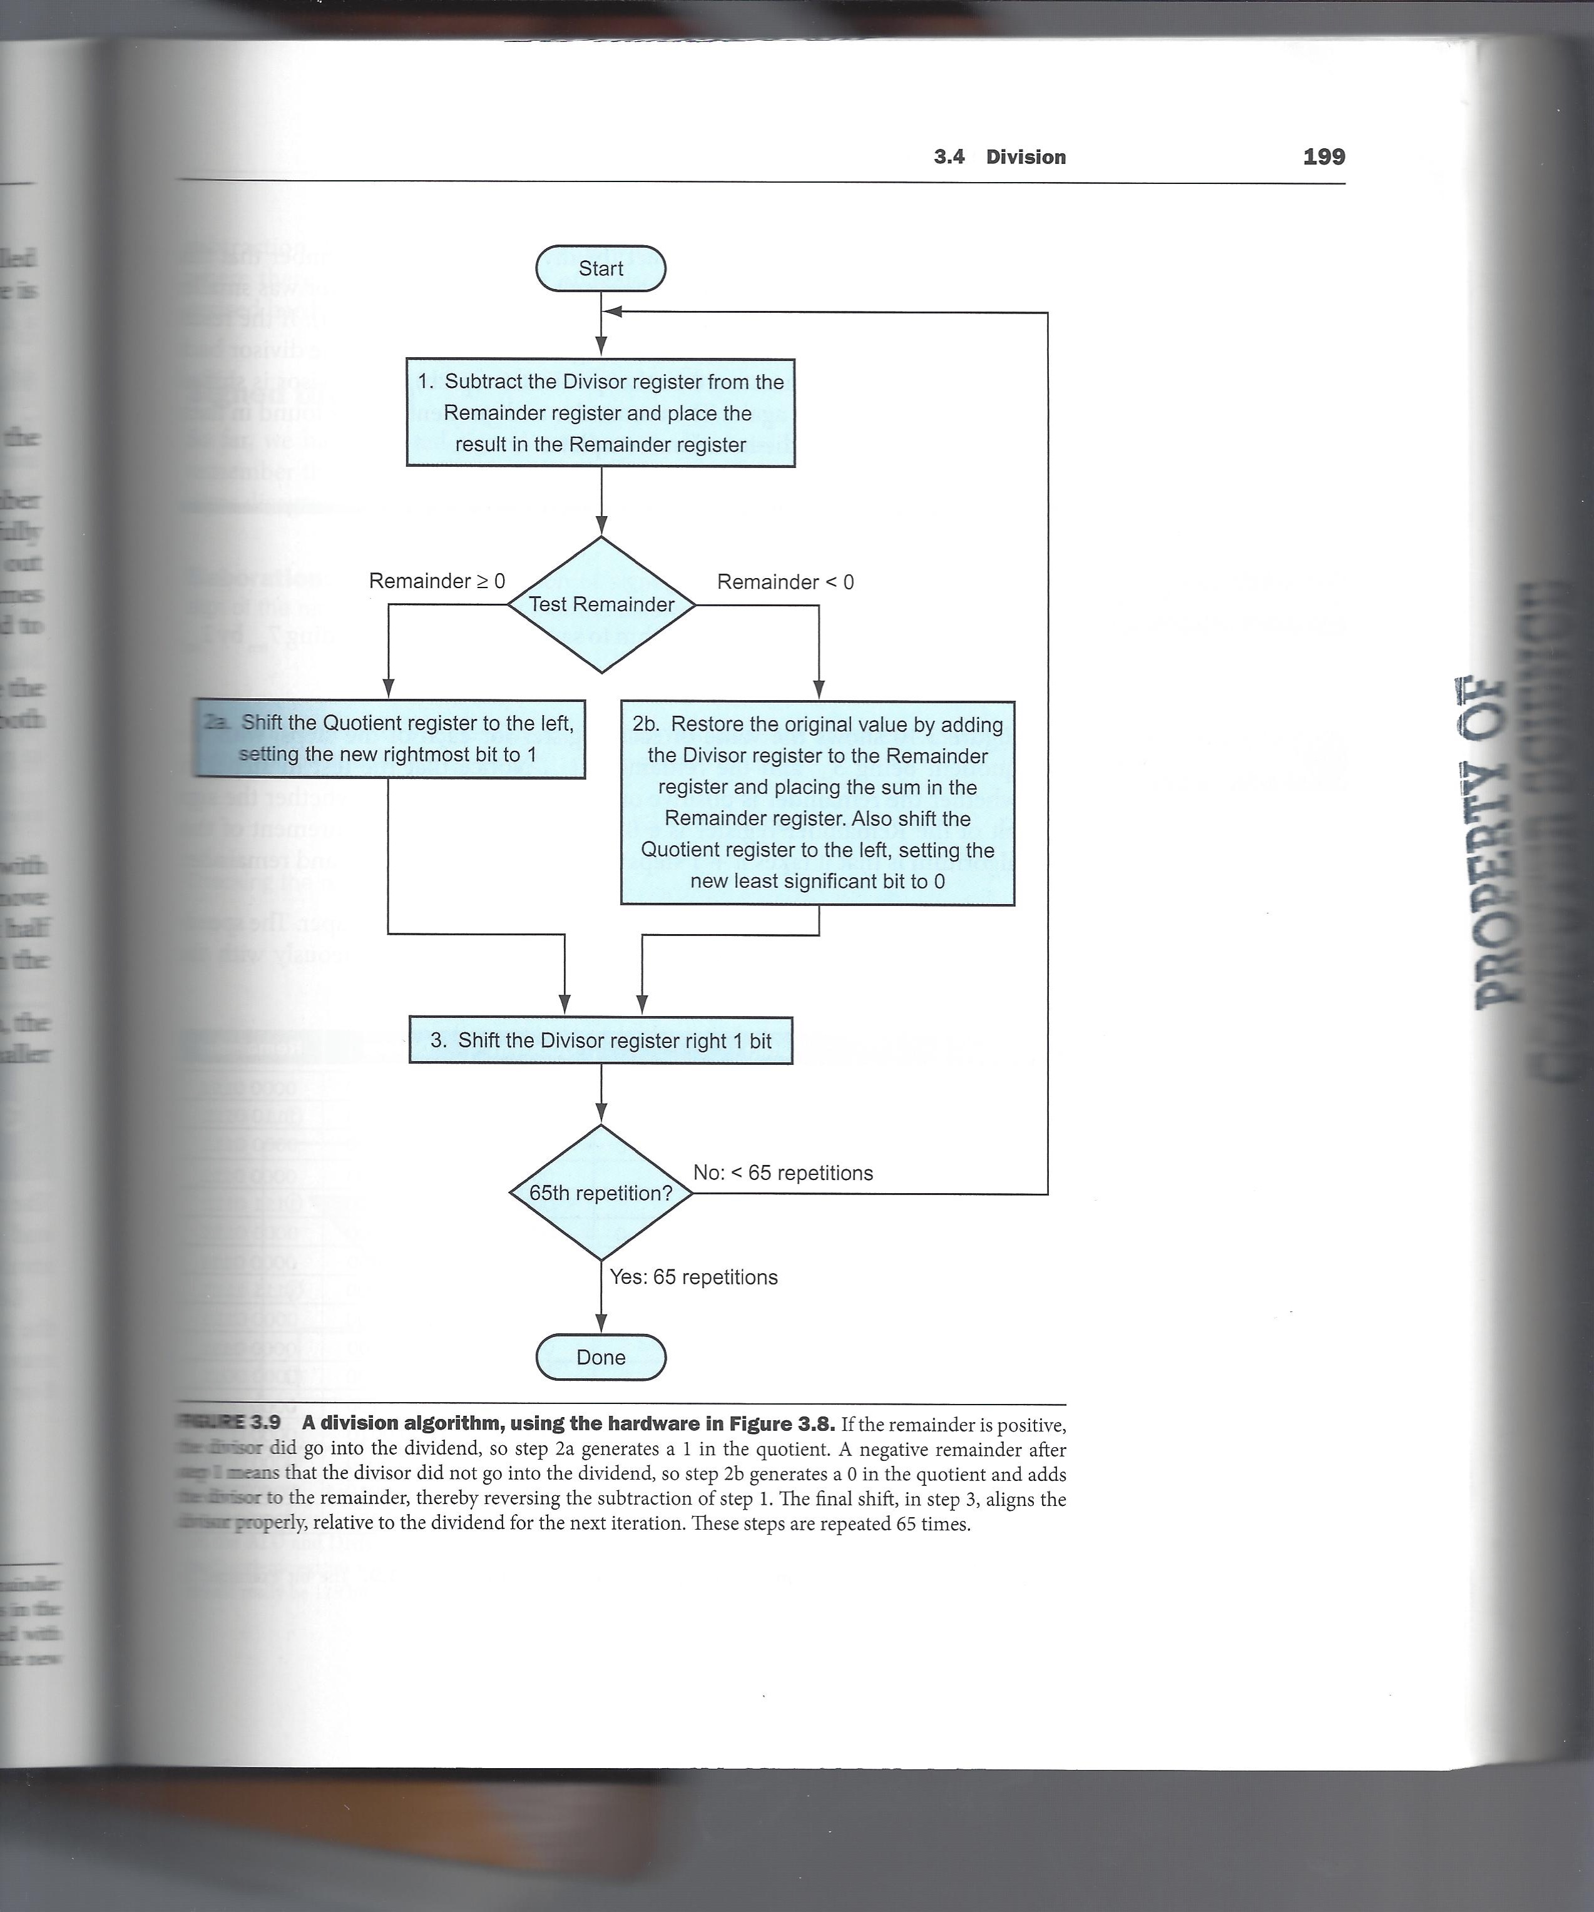
Division
We checked to see if divisor ≤ dividend bits
Instead, we can subtract divisor from dividend
If result is < 0, we add divisor back (restore)
Restoring division
Other division algorithms
Non-Restoring division
ARMv8 has two division instructions
SDIV (signed)
UDIV (unsigned)
Both instructions ignore overflow
and division-by-zero

Slide 14
Division
Divide 107 by 10
107 = 0110 1011 and 10 = 01010. We also need -10 = 10110
Note we need to maintain a sign bit since we want to detect negative values to see if the divisor goes into the dividend or not. Let us start with a ten bit dividend and 5 bit divisor
Step 0: Initialize Remainder = Dividend R = 00011 01011
Step 1: subtract divisor (-10) + 10110 00000
result is negative and quotient bit = 0 = 11001 01011
need to restore by adding divisor (+10) + 01010 00000
= 00011 01011
Shift dividend left Q0 = 0 = 00110 10110
Step 2: Subtract divisor (-10) + 10110 00000
result is negative, so Q0 = 0 = 11100 10110
restore (add divisor) (+10) + 01010 00000
= 00110 10110
shift left with quotient bit = 01101 01100

Slide 15
Division
Result from step 2 01101 01100
Step 3: Subtract divisor (-10) + 10110 00000
result is positive, Q0 = 1 = 00011 01100
shift left with quotient bit = 00110 11001
Step 4: Subtract divisor (-10) + 10110 00000
result is negative, Q0 = 0 = 11100 11001
restore (add divisor) (+10) + 01010 00000
= 00110 11001
shift left with quotient = 01101 10010
Step 5: Subtract divisor (-10) + 10110 00000
result is positive, Q0 = 1 = 00011 10010
shift left with quotient bit = 00111 00101
Step 6: Subtract divisor (-10) + 10110 00000
result is negative, Q0 = 0 = 11101 00101
restore (+10) + 01010 00000
= 00111 00101
shift left with quotient = 01110 01010
Note remainder always looks like shifted to the left by one place because of the method used.
Since we have 5 bit divisor, we repeat the process for 6 times
(that is why we have to shift the remainder right one time to correct for the extra cycle)

Slide 16
Division
Another Example: Problem 3.19: Divide 74 by 21
Divisor = 21 = 0001 0101 -Divisor = 1110 1011
Dividend (twice as long as divisor)=74= 0000 0000 0100 1010
Cycle 0 | Initial Dividend |  | 0 | 0 | 0 | 0 | 0 | 0 | 0 | 0 | 0 | 1 | 0 | 0 | 1 | 0 | 1 | 0
Cycle 1 | Subtract divisor |  | 1 | 1 | 1 | 0 | 1 | 0 | 1 | 1
 | = |  | 1 | 1 | 1 | 0 | 1 | 0 | 1 | 1 | 0 | 1 | 0 | 0 | 1 | 0 | 1 | 0
 | Negative, restore |  | 0 | 0 | 0 | 1 | 0 | 1 | 0 | 1
 |  |  | 0 | 0 | 0 | 0 | 0 | 0 | 0 | 0 | 0 | 1 | 0 | 0 | 1 | 0 | 1 | 0
 | Shift Left with Q=0 |  | 0 | 0 | 0 | 0 | 0 | 0 | 0 | 0 | 1 | 0 | 0 | 1 | 0 | 1 | 0 | 0
Cycle 2 | Subtract divisor |  | 1 | 1 | 1 | 0 | 1 | 0 | 1 | 1
 | = |  | 1 | 1 | 1 | 0 | 1 | 0 | 1 | 1 | 1 | 0 | 0 | 1 | 0 | 1 | 0 | 0
 | Negative, restore |  | 0 | 0 | 0 | 1 | 0 | 1 | 0 | 1
 |  |  | 0 | 0 | 0 | 0 | 0 | 0 | 0 | 0 | 1 | 0 | 0 | 1 | 0 | 1 | 0 | 0
 | Shift Left with Q=0 |  | 0 | 0 | 0 | 0 | 0 | 0 | 0 | 1 | 0 | 0 | 1 | 0 | 1 | 0 | 0 | 0
Cycle 3 | Subtract divisor |  | 1 | 1 | 1 | 0 | 1 | 0 | 1 | 1
 | = |  | 1 | 1 | 1 | 0 | 1 | 1 | 0 | 0 | 0 | 0 | 1 | 0 | 1 | 0 | 0 | 0
 | Negative, restore |  | 0 | 0 | 0 | 1 | 0 | 1 | 0 | 1
 |  |  | 0 | 0 | 0 | 0 | 0 | 0 | 0 | 1 | 0 | 0 | 1 | 0 | 1 | 0 | 0 | 0
 | Shift Left with Q=0 |  | 0 | 0 | 0 | 0 | 0 | 0 | 1 | 0 | 0 | 1 | 0 | 1 | 0 | 0 | 0 | 0

Slide 17
Division
 | (previous value) |  | 0 | 0 | 0 | 0 | 0 | 0 | 1 | 0 | 0 | 1 | 0 | 1 | 0 | 0 | 0 | 0
Cycle 4 | Subtract divisor |  | 1 | 1 | 1 | 0 | 1 | 0 | 1 | 1
 | = |  | 1 | 1 | 1 | 0 | 1 | 1 | 0 | 1 | 0 | 1 | 0 | 1 | 0 | 0 | 0 | 0
 | Negative, restore |  | 0 | 0 | 0 | 1 | 0 | 1 | 0 | 1
 |  |  | 0 | 0 | 0 | 0 | 0 | 0 | 1 | 0 | 0 | 1 | 0 | 1 | 0 | 0 | 0 | 0
 | Shift Left with Q=0 |  | 0 | 0 | 0 | 0 | 0 | 1 | 0 | 0 | 1 | 0 | 1 | 0 | 0 | 0 | 0 | 0
Cycle 5 | Subtract divisor |  | 1 | 1 | 1 | 0 | 1 | 0 | 1 | 1
 | = |  | 1 | 1 | 1 | 0 | 1 | 1 | 1 | 1 | 1 | 0 | 1 | 0 | 0 | 0 | 0 | 0
 | Negative, restore |  | 0 | 0 | 0 | 1 | 0 | 1 | 0 | 1
 |  |  | 0 | 0 | 0 | 0 | 0 | 1 | 0 | 0 | 1 | 0 | 1 | 0 | 0 | 0 | 0 | 0
 | Shift Left with Q=0 |  | 0 | 0 | 0 | 0 | 1 | 0 | 0 | 1 | 0 | 1 | 0 | 0 | 0 | 0 | 0 | 0
Cycle 6 | Subtract divisor |  | 1 | 1 | 1 | 0 | 1 | 0 | 1 | 1
 | = |  | 1 | 1 | 1 | 1 | 0 | 1 | 0 | 0 | 0 | 1 | 0 | 0 | 0 | 0 | 0 | 0
 | Negative, restore |  | 0 | 0 | 0 | 1 | 0 | 1 | 0 | 1
 |  |  | 0 | 0 | 0 | 0 | 1 | 0 | 0 | 1 | 0 | 1 | 0 | 0 | 0 | 0 | 0 | 0
 | Shift Left with Q=0 |  | 0 | 0 | 0 | 1 | 0 | 0 | 1 | 0 | 1 | 0 | 0 | 0 | 0 | 0 | 0 | 0

Slide 18
Division
 | (previous value) |  | 0 | 0 | 0 | 1 | 0 | 0 | 1 | 0 | 1 | 0 | 0 | 0 | 0 | 0 | 0 | 0
Cycle 7 | Subtract divisor |  | 1 | 1 | 1 | 0 | 1 | 0 | 1 | 1
 | = |  | 1 | 1 | 1 | 1 | 1 | 1 | 0 | 1 | 1 | 0 | 0 | 0 | 0 | 0 | 0 | 0
 | Negative, restore |  | 0 | 0 | 0 | 1 | 0 | 1 | 0 | 1
 |  |  | 0 | 0 | 0 | 1 | 0 | 0 | 1 | 0 | 1 | 0 | 0 | 0 | 0 | 0 | 0 | 0
 | Shift Left with Q=0 |  | 0 | 0 | 1 | 0 | 0 | 1 | 0 | 1 | 0 | 0 | 0 | 0 | 0 | 0 | 0 | 0
Cycle 8 | Subtract divisor |  | 1 | 1 | 1 | 0 | 1 | 0 | 1 | 1
 | = |  | 0 | 0 | 0 | 1 | 0 | 0 | 0 | 0 | 0 | 0 | 0 | 0 | 0 | 0 | 0 | 0
 | Positive, SHL with Q=1 |  | 0 | 0 | 1 | 0 | 0 | 0 | 0 | 0 | 0 | 0 | 0 | 0 | 0 | 0 | 0 | 1
Cycle 9 | Subtract divisor |  | 1 | 1 | 1 | 0 | 1 | 0 | 1 | 1
 | = |  | 0 | 0 | 0 | 0 | 1 | 0 | 1 | 1 | 0 | 0 | 0 | 0 | 0 | 0 | 0 | 1
 | Positive, SHL with Q=1 |  | 0 | 0 | 0 | 1 | 0 | 1 | 1 | 0 | 0 | 0 | 0 | 0 | 0 | 0 | 1 | 1
Quotient (right half result) = 0000 0011 (=3_{ten})
Remainder (left half result) = 0001 0110 ➔ must be shifted right once
= 0000 1011 (=11_{ten})
74/21: Quotient = 3 and Remainder = 11
Note: you repeat this process (number bits in divisor)+1

Slide 19
Division
Another Example: Divide 62 by 12 using 8 bit numbers. 62 =0011 1110; 12 = 0000 1100
Dividend with double the number bits as the divisor
Dividend = 0000 0000 0011 1110; Divisor = 0000 1100; -Divisor = 1111 0100
Need 9 cycles of subtract divisor, restore if necessary and shift left
 | Initial value of dividend |  | 0 | 0 | 0 | 0 | 0 | 0 | 0 | 0 | 0 | 0 | 1 | 1 | 1 | 1 | 1 | 0
Cycle 1 | Subtract divisor | + | 1 | 1 | 1 | 1 | 0 | 1 | 0 | 0
 | Negative | = | 1 | 1 | 1 | 1 | 0 | 1 | 0 | 0 | 0 | 0 | 1 | 1 | 1 | 1 | 1 | 0
 | Restore | + | 0 | 0 | 0 | 0 | 1 | 1 | 0 | 0
 | SHL with Q=0 | = | 0 | 0 | 0 | 0 | 0 | 0 | 0 | 0 | 0 | 0 | 1 | 1 | 1 | 1 | 1 | 0
 |  |  | 0 | 0 | 0 | 0 | 0 | 0 | 0 | 0 | 0 | 1 | 1 | 1 | 1 | 1 | 0 | 0
Cylcle 2 | Subtract divisor | + | 1 | 1 | 1 | 1 | 0 | 1 | 0 | 0
 | negative | = | 1 | 1 | 1 | 1 | 0 | 1 | 0 | 0 | 0 | 1 | 1 | 1 | 1 | 1 | 0 | 0
 | restore | + | 0 | 0 | 0 | 0 | 1 | 1 | 0 | 0
 | SHL with Q=0 | = | 0 | 0 | 0 | 0 | 0 | 0 | 0 | 0 | 0 | 1 | 1 | 1 | 1 | 1 | 0 | 0
 |  |  | 0 | 0 | 0 | 0 | 0 | 0 | 0 | 0 | 1 | 1 | 1 | 1 | 1 | 0 | 0 | 0

Slide 20
Division
Previous value in divisor |  | 0 | 0 | 0 | 0 | 0 | 0 | 0 | 0 | 1 | 1 | 1 | 1 | 1 | 0 | 0 | 0
Cycle 3 | Subtract divisor | + | 1 | 1 | 1 | 1 | 0 | 1 | 0 | 0
 | Negative | = | 1 | 1 | 1 | 1 | 0 | 1 | 0 | 0 | 1 | 1 | 1 | 1 | 1 | 0 | 0 | 0
 | restore | + | 0 | 0 | 0 | 0 | 1 | 1 | 0 | 0
 | SHL with Q=0 | = | 0 | 0 | 0 | 0 | 0 | 0 | 0 | 0 | 1 | 1 | 1 | 1 | 1 | 0 | 0 | 0
 |  |  | 0 | 0 | 0 | 0 | 0 | 0 | 0 | 1 | 1 | 1 | 1 | 1 | 0 | 0 | 0 | 0
Cycle 4 | Subtract divisor | + | 1 | 1 | 1 | 1 | 0 | 1 | 0 | 0
 | Negative | = | 1 | 1 | 1 | 1 | 0 | 1 | 0 | 1 | 1 | 1 | 1 | 1 | 0 | 0 | 0 | 0
 | restore | + | 0 | 0 | 0 | 0 | 1 | 1 | 0 | 0
 | SHL with Q=0 | = | 0 | 0 | 0 | 0 | 0 | 0 | 0 | 1 | 1 | 1 | 1 | 1 | 0 | 0 | 0 | 0
 |  |  | 0 | 0 | 0 | 0 | 0 | 0 | 1 | 1 | 1 | 1 | 1 | 0 | 0 | 0 | 0 | 0
Cycle 5 | Subtract divisor | + | 1 | 1 | 1 | 1 | 0 | 1 | 0 | 0
 | Negative | = | 1 | 1 | 1 | 1 | 0 | 1 | 1 | 1 | 1 | 1 | 1 | 0 | 0 | 0 | 0 | 0
 | restore | + | 0 | 0 | 0 | 0 | 1 | 1 | 0 | 0
 | SHL with Q=0 | = | 0 | 0 | 0 | 0 | 0 | 0 | 1 | 1 | 1 | 1 | 1 | 0 | 0 | 0 | 0 | 0
 |  |  | 0 | 0 | 0 | 0 | 0 | 1 | 1 | 1 | 1 | 1 | 0 | 0 | 0 | 0 | 0 | 0

Slide 21
Division
 | Previous value in divisor |  | 0 | 0 | 0 | 0 | 0 | 1 | 1 | 1 | 1 | 1 | 0 | 0 | 0 | 0 | 0 | 0
Cycle 6 | Subtract divisor | + | 1 | 1 | 1 | 1 | 0 | 1 | 0 | 0
 | Negative | = | 1 | 1 | 1 | 1 | 1 | 0 | 1 | 1 | 1 | 1 | 0 | 0 | 0 | 0 | 0 | 0
 | restore | + | 0 | 0 | 0 | 0 | 1 | 1 | 0 | 0
 | SHL with Q=0 | = | 0 | 0 | 0 | 0 | 0 | 1 | 1 | 1 | 1 | 1 | 0 | 0 | 0 | 0 | 0 | 0
 |  |  | 0 | 0 | 0 | 0 | 1 | 1 | 1 | 1 | 1 | 0 | 0 | 0 | 0 | 0 | 0 | 0
Cycle 7 | Subtract divisor | + | 1 | 1 | 1 | 1 | 0 | 1 | 0 | 0
 | Positive | = | 0 | 0 | 0 | 0 | 0 | 0 | 1 | 1 | 1 | 0 | 0 | 0 | 0 | 0 | 0 | 0
 | SHL with Q=1 |  | 0 | 0 | 0 | 0 | 0 | 1 | 1 | 1 | 0 | 0 | 0 | 0 | 0 | 0 | 0 | 1
Cycle 8 | Subtract divisor | + | 1 | 1 | 1 | 1 | 0 | 1 | 0 | 0
 | Negative | = | 1 | 1 | 1 | 1 | 1 | 0 | 1 | 1 | 0 | 0 | 0 | 0 | 0 | 0 | 0 | 1
 | restore | + | 0 | 0 | 0 | 0 | 1 | 1 | 0 | 0
 | SHL with Q=0 | = | 0 | 0 | 0 | 0 | 0 | 1 | 1 | 1 | 0 | 0 | 0 | 0 | 0 | 0 | 0 | 1
 |  |  | 0 | 0 | 0 | 0 | 1 | 1 | 1 | 0 | 0 | 0 | 0 | 0 | 0 | 0 | 1 | 0

Slide 22
Division
 | Previous value in divisor |  | 0 | 0 | 0 | 0 | 1 | 1 | 1 | 0 | 0 | 0 | 0 | 0 | 0 | 0 | 1 | 0
Cycle 9 | Subtract divisor | + | 1 | 1 | 1 | 1 | 0 | 1 | 0 | 0
 | Positive | = | 0 | 0 | 0 | 0 | 0 | 0 | 1 | 0 | 0 | 0 | 0 | 0 | 0 | 0 | 1 | 0
 | SHL with Q=1 |  | 0 | 0 | 0 | 0 | 0 | 1 | 0 | 0 | 0 | 0 | 0 | 0 | 0 | 1 | 0 | 1
62/12 Quotient = 0000 0101 = 5 and remainder = 0000 0010 = 2
Try a few examples on your own
Assignment 3 includes one multiplication and one division problem
But try some additional problems
Signed Multiplication and Division
Sign of Result: (S_{multiplicand}) EXCL-OR (S_{multiplier})
Or for division: (S_{dividend}) EXCL-OR (S_{divisor})
If either number is negative, take 2’s complement of that number
Multiply or divide only positive numbers
If the sign of the result is negative (1), complement result

